Slide 1
How Does MS Work? Ehsan Zangene 5th session Time: 10-12 Place: Biomedicum 1, kok.3

Slide 2
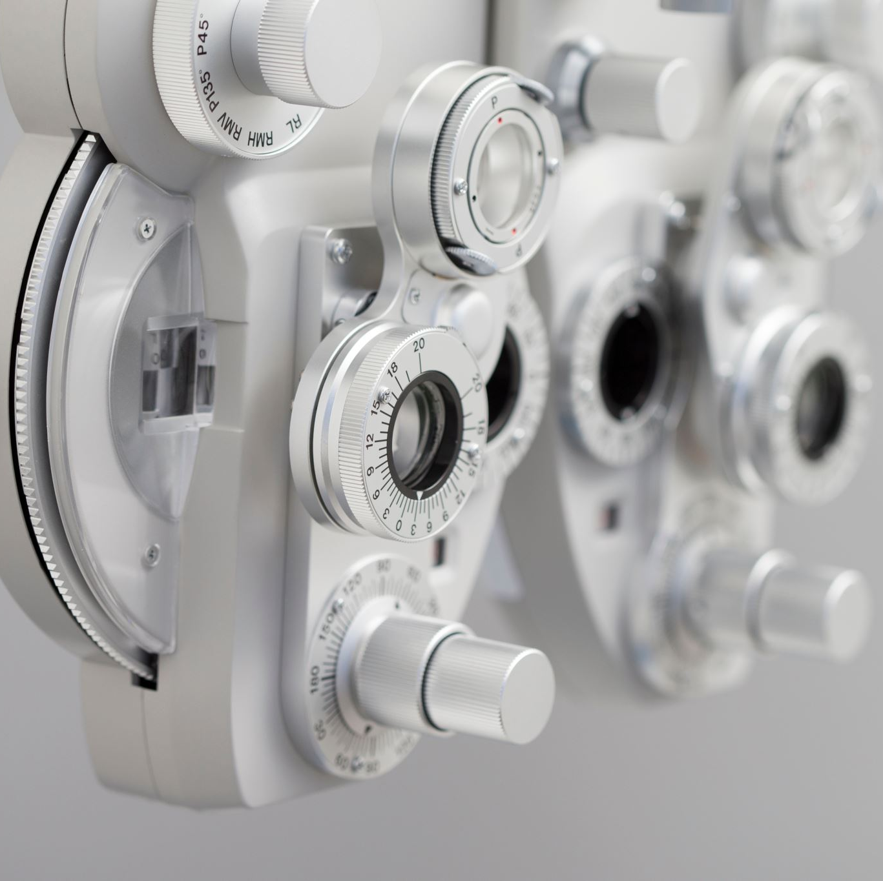
At the end of this session you should know:
Principles of mass spectrometry
Components of MS instruments
Tandem MS
Data acquisition techniques
DDA/DIA
TMT labelling

Slide 3

Individual assignment 15 min

Slide 4
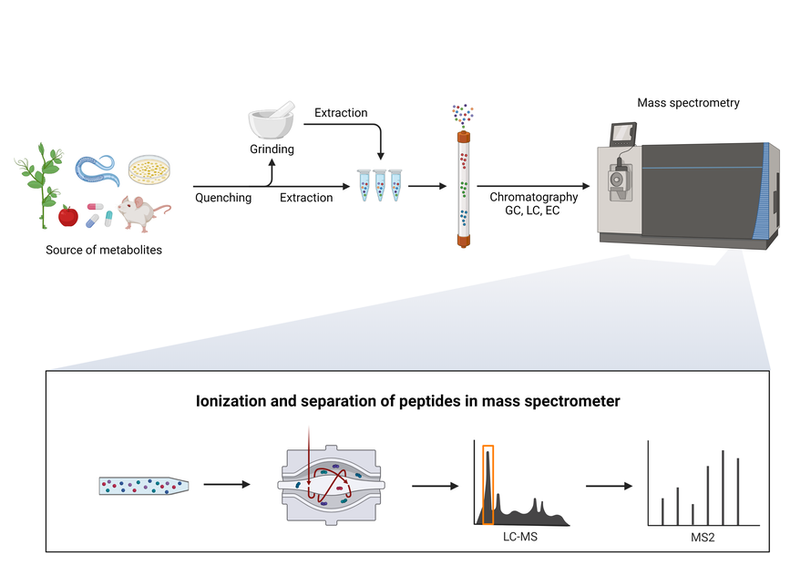
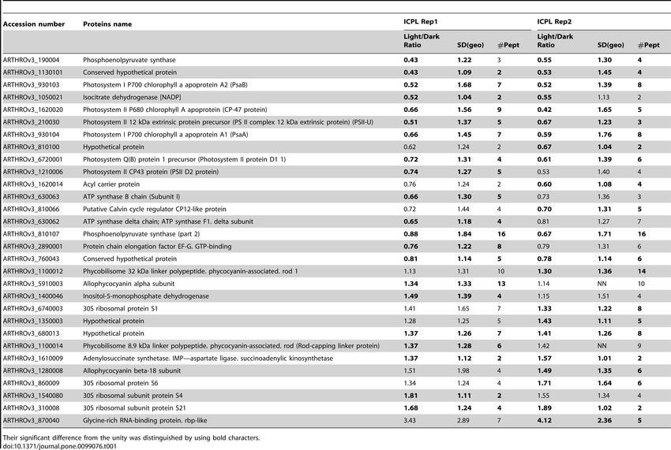
workflow
???
https://pel.caltech.edu/approach

Slide 5
workflow
???
https://pel.caltech.edu/approach

Slide 6
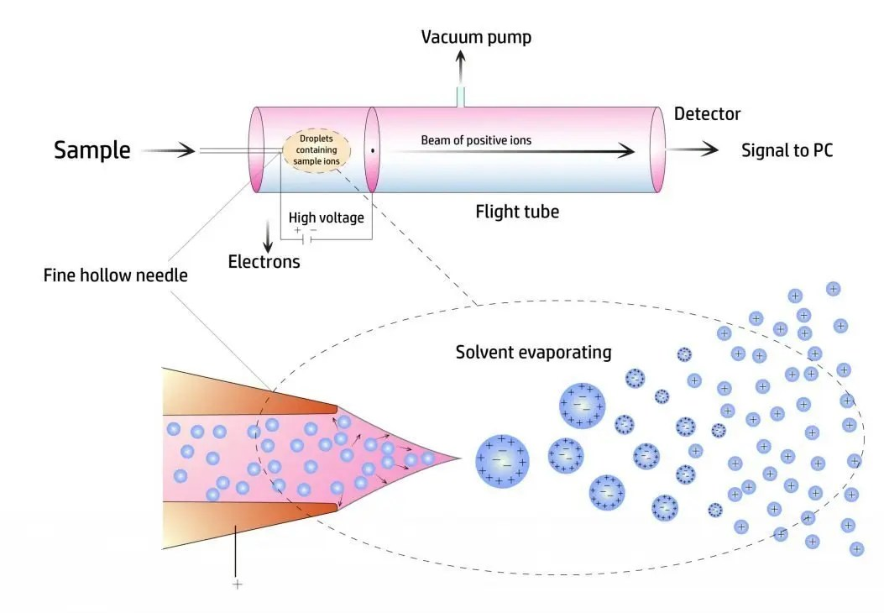
Principles of mass spectrometry
mass spectrometers do not measure mass
generating charged particles (ions) to generate ion beam
ion beam manipulated under high vacuum
measure ions mass to charge ratio
Parent ions
daughter ions (fragmented)

Slide 7
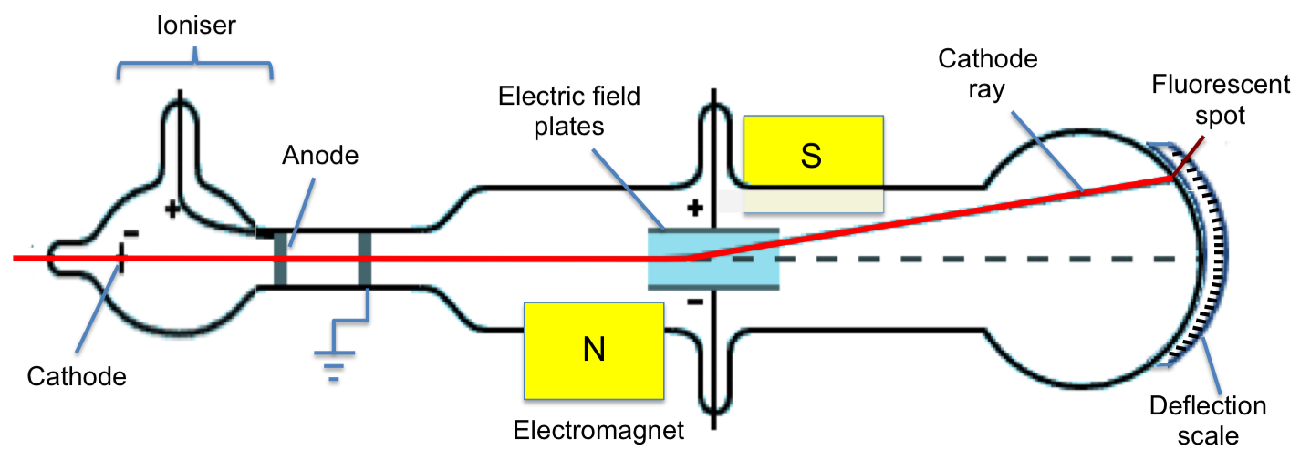
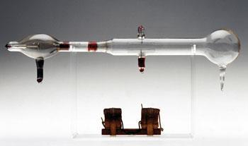
Invented by jj thompson in 1913
Cathode with voltage applied to it
(ion Source)
beam
bent
Collimated beam
slits
evacuated tube filled with gas
Two mass filters
- magnetic coils -> magnetic field
- electrical diffraction plates -> electrical field
detector -> fluorescent coating
it will fluoresce when charged particle beam hits
He was able to separate different Neon isotope
https://monomole.com/mass-spectrometry-thomson-cathode-ray/

Slide 8
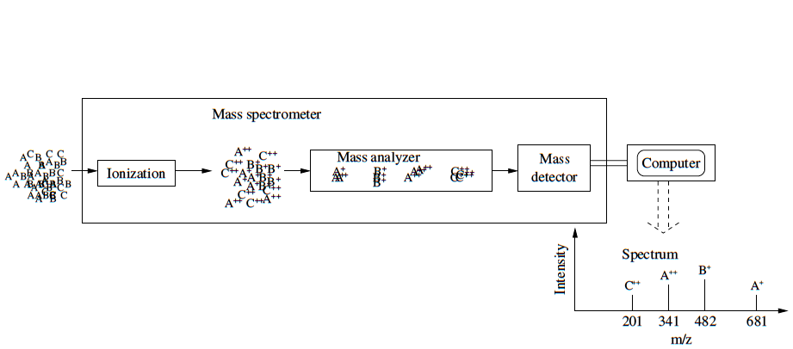
Nominal masses
A: 680
B: 481
C: 400
A: (680+1)/1=681 and (680+2)/2=341
B: 482
C: 201

Slide 9
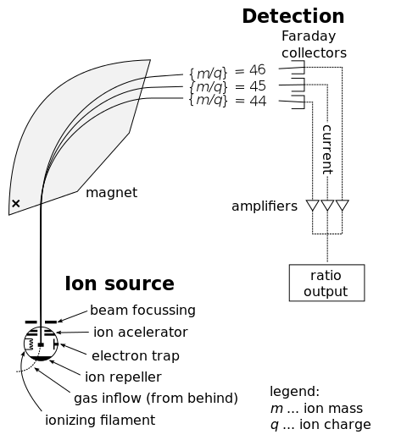
An array of decetecor
= spectrum
Mass filter
https://thornsandthistleshomestead.wordpress.com/2014/12/04/essential-oil-testing-deeper-dive-mass-spec/

Slide 10
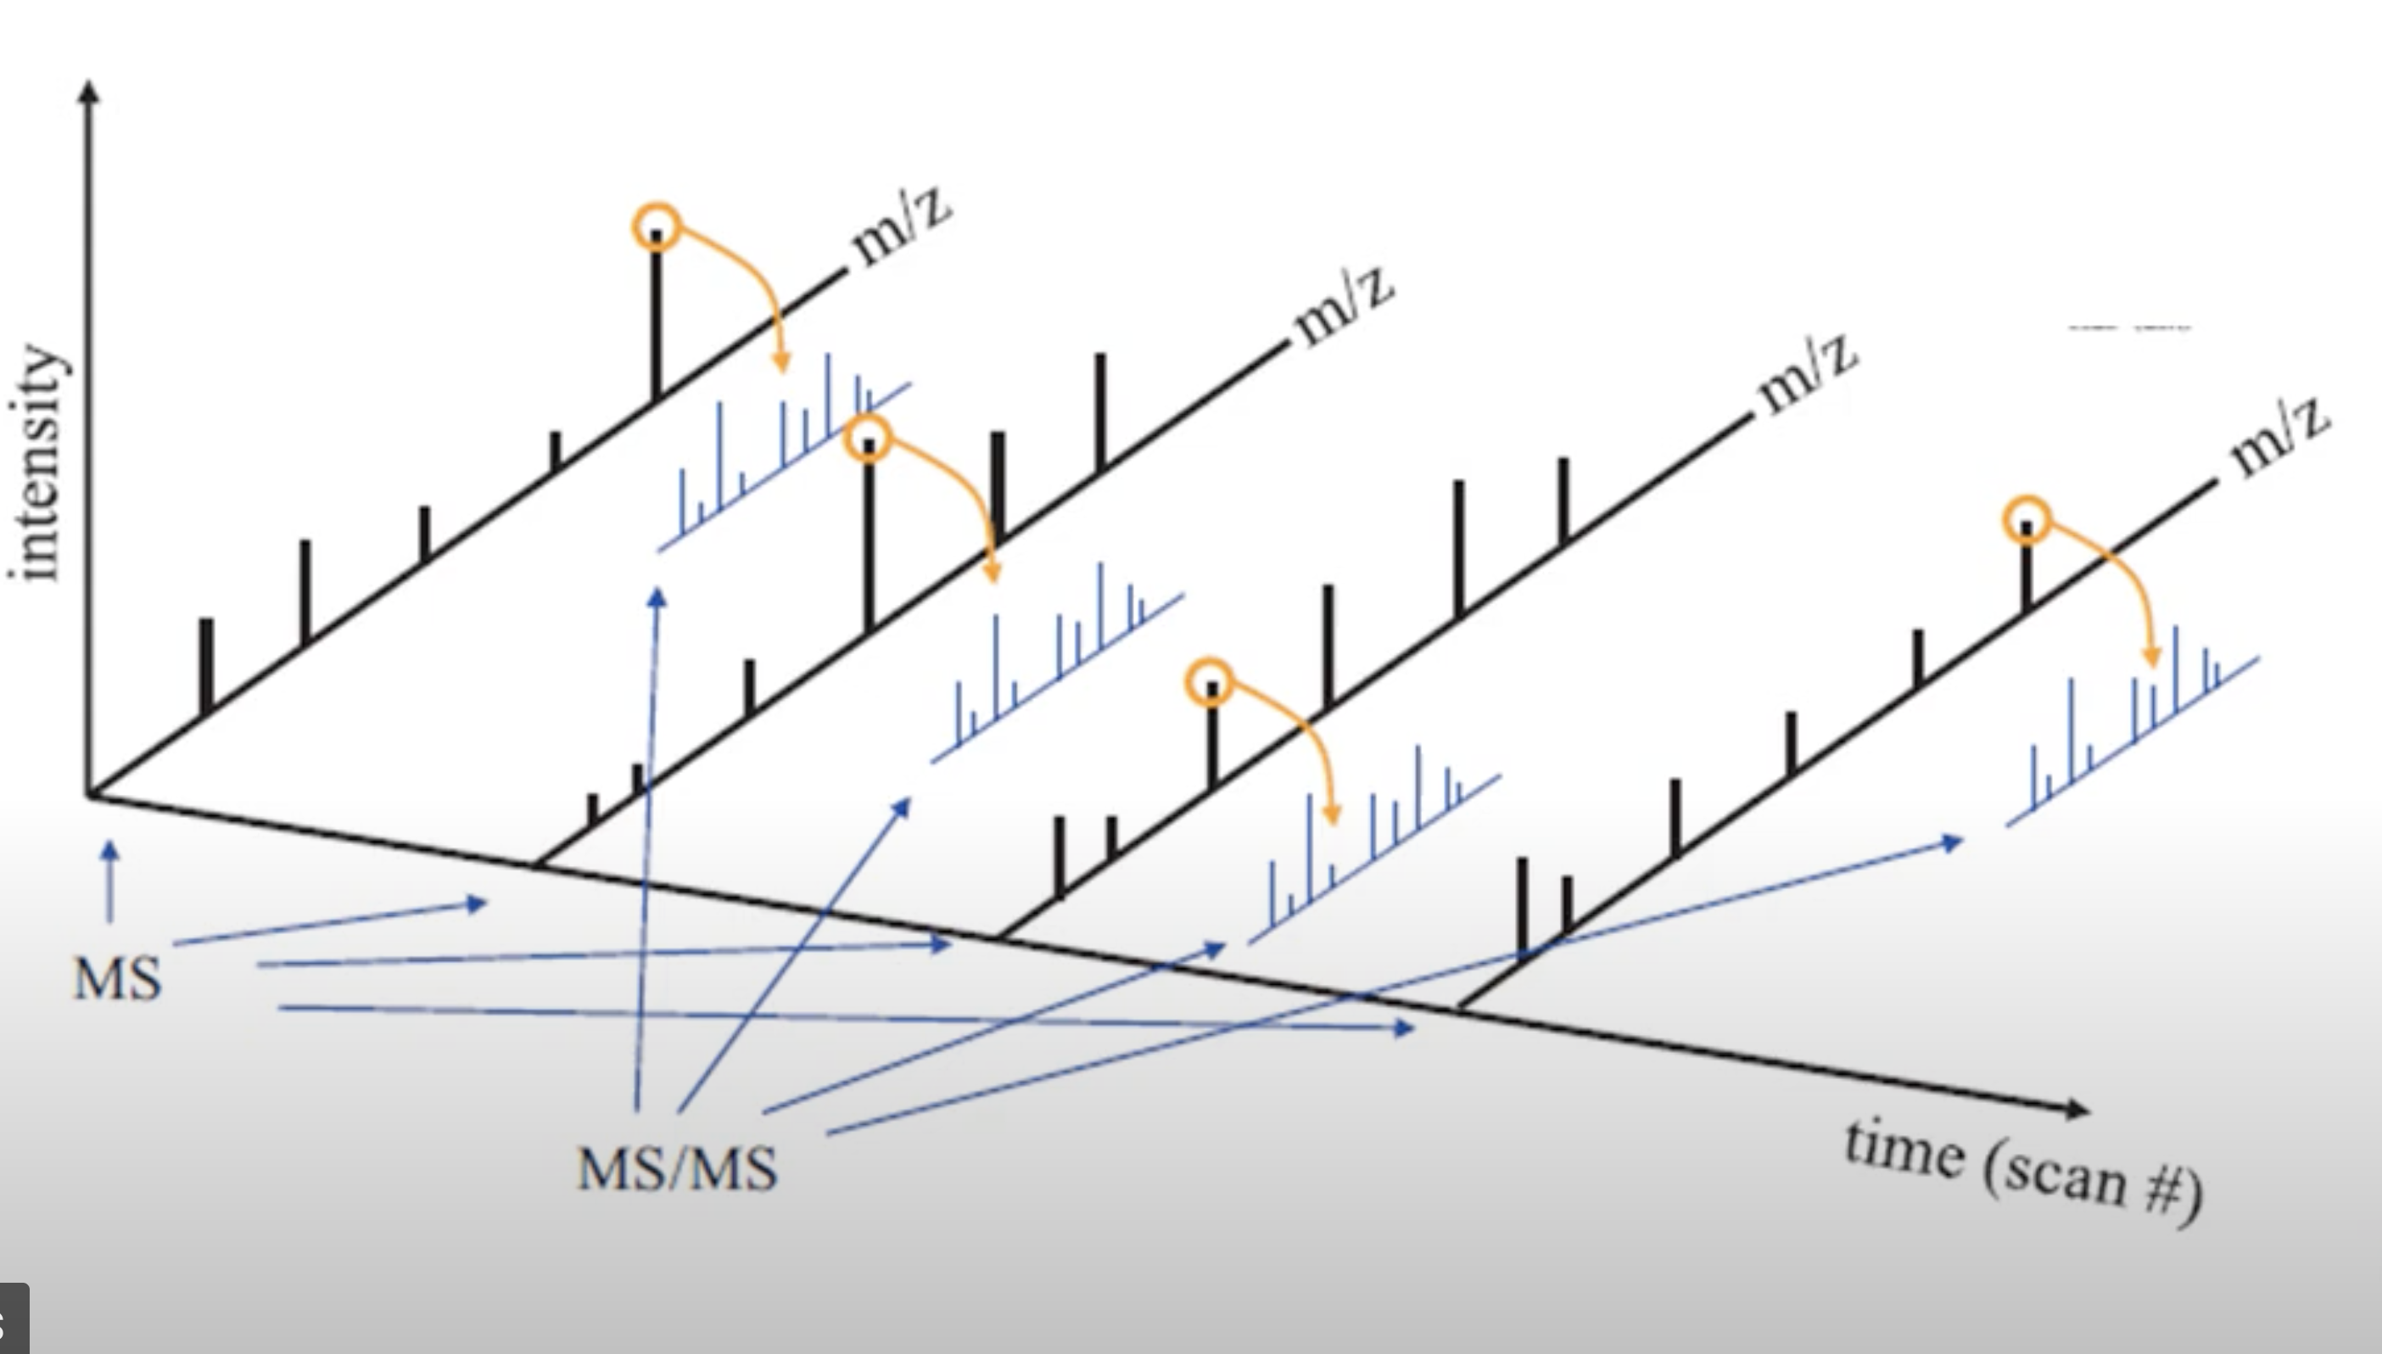

Slide 11
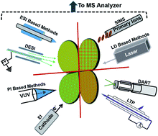
Ionization sources
Electrospray
MALDI
Other methods
https://pubs.rsc.org/en/content/articlelanding/2014/np/c3np70094a

Slide 12
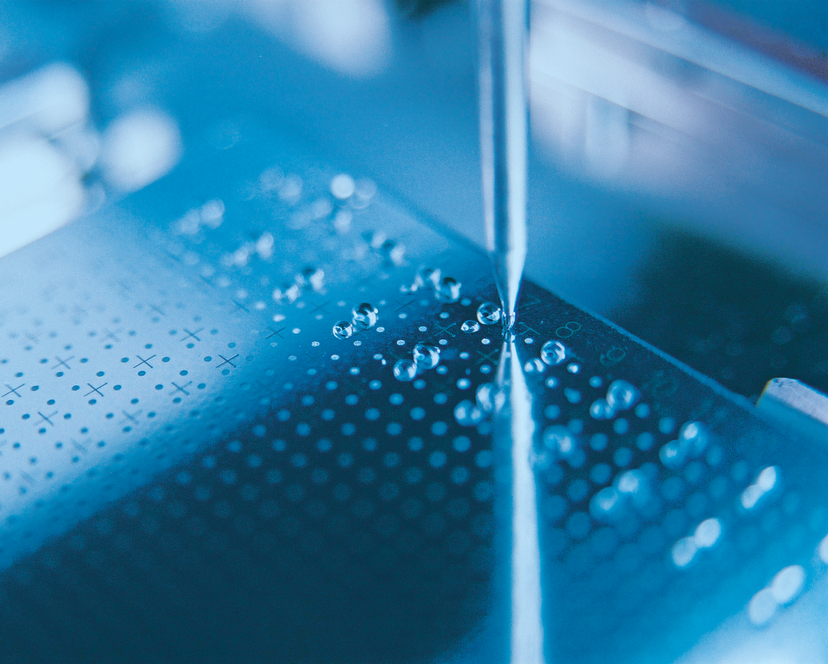
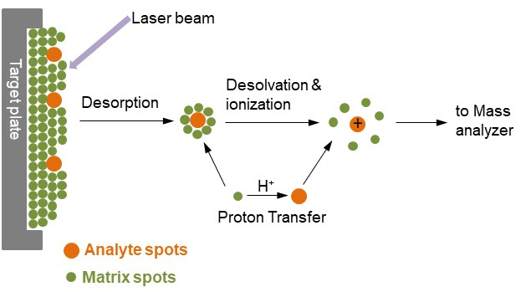
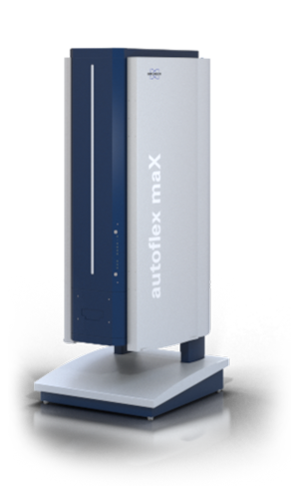
matrix assisted laser desorption ionization
https://www.researchgate.net/figure/Mechanism-of-matrix-assisted-laser-desorption-ionization-process_fig3_335037795

Slide 13
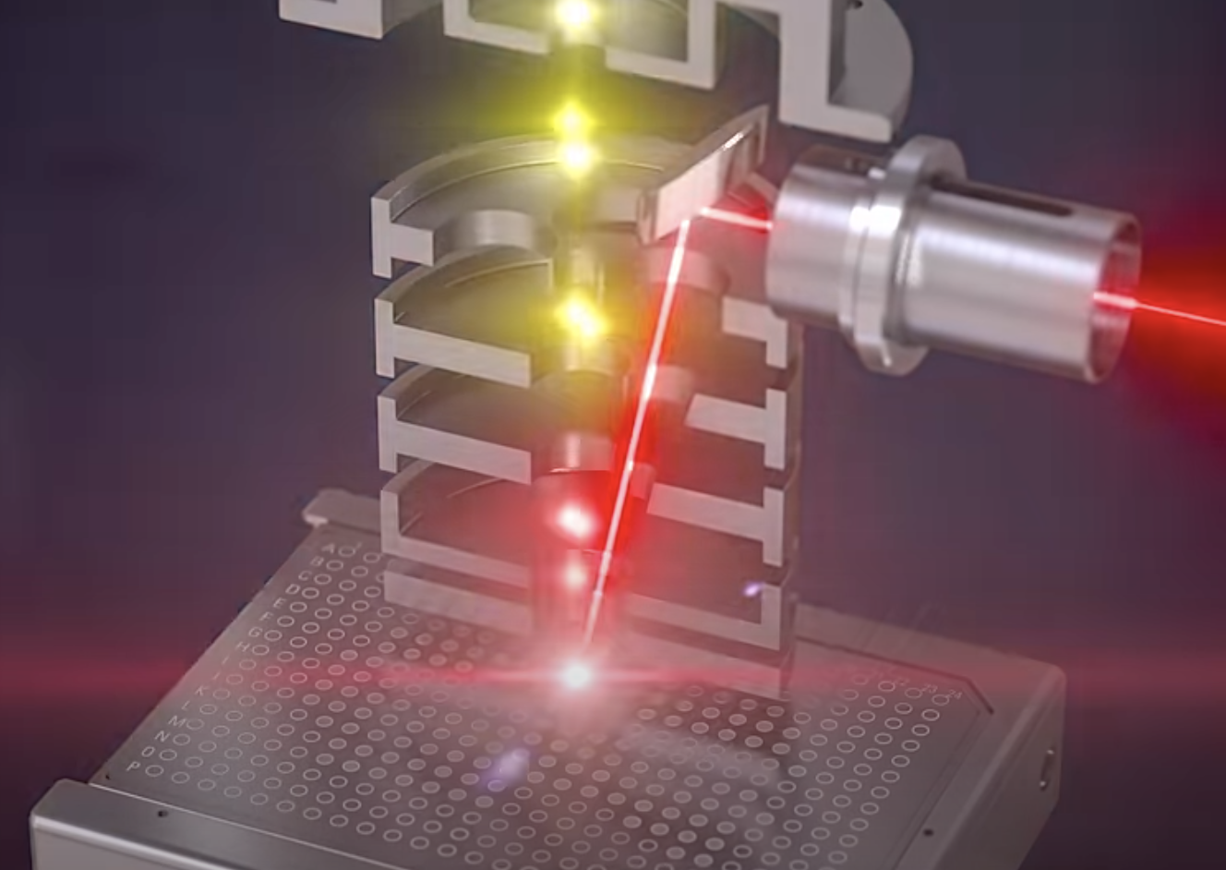
https://www.youtube.com/watch?v=0jeFpXHZ8W0

Slide 14
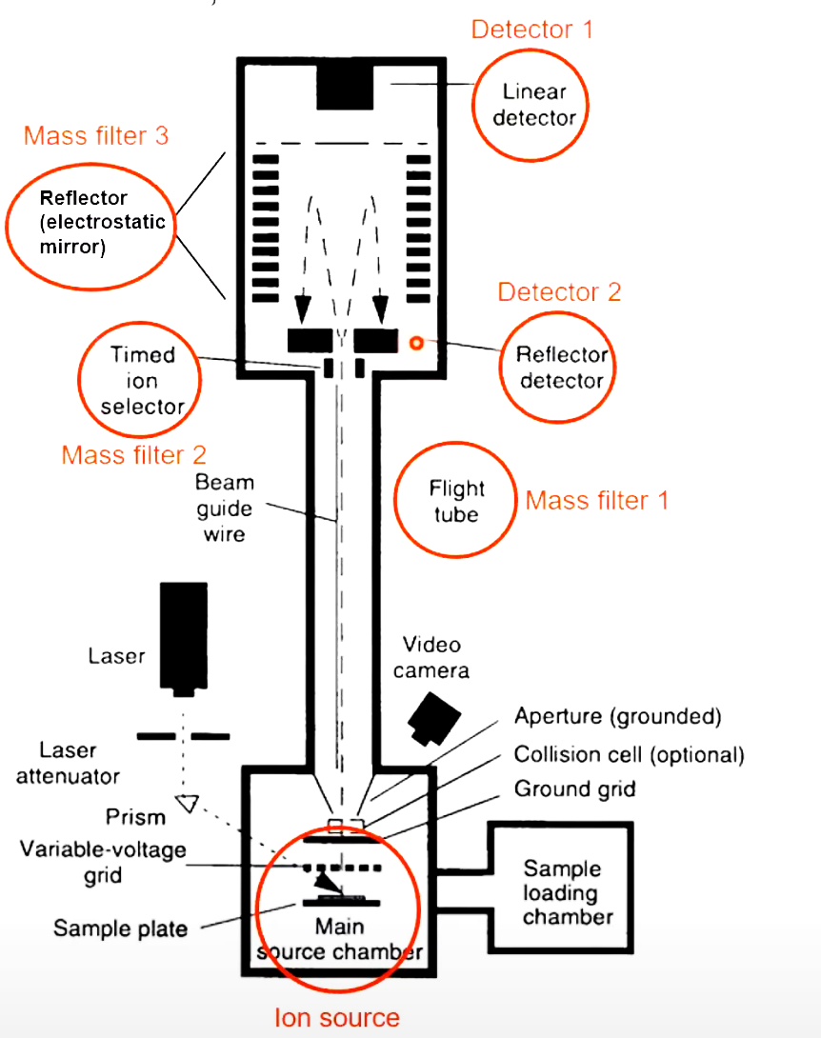
http://www.chem.cmu.edu/cma/maldischem.html

Slide 15
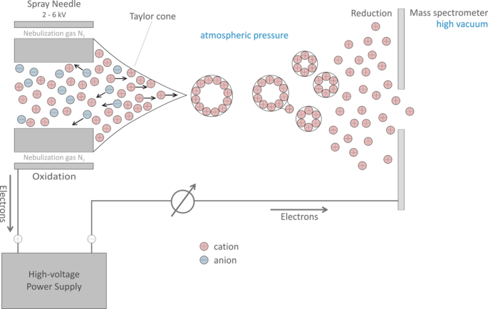
https://www.youtube.com/watch?v=9AWBAI-Owzk

Slide 16
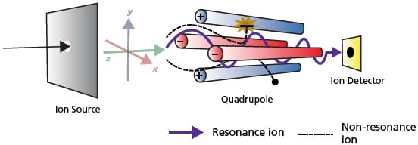
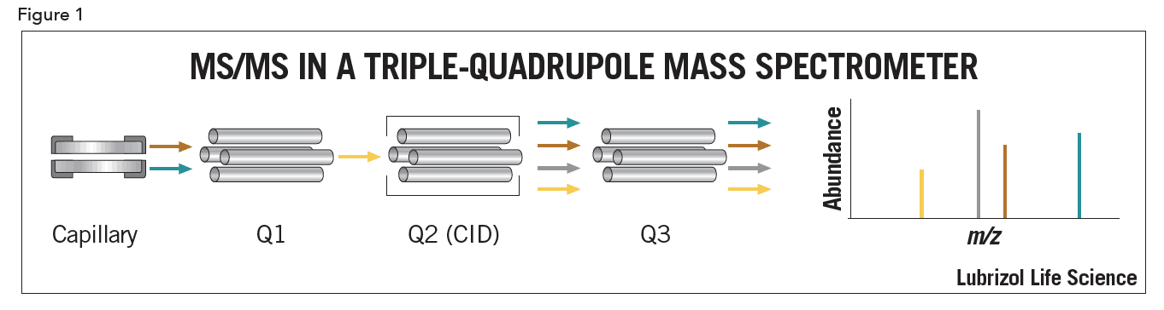
Good for partent ions selection
https://www.shimadzu.com/an/service-support/technical-support/analysis-basics/fundamental/mass_analyzers.html

Slide 17
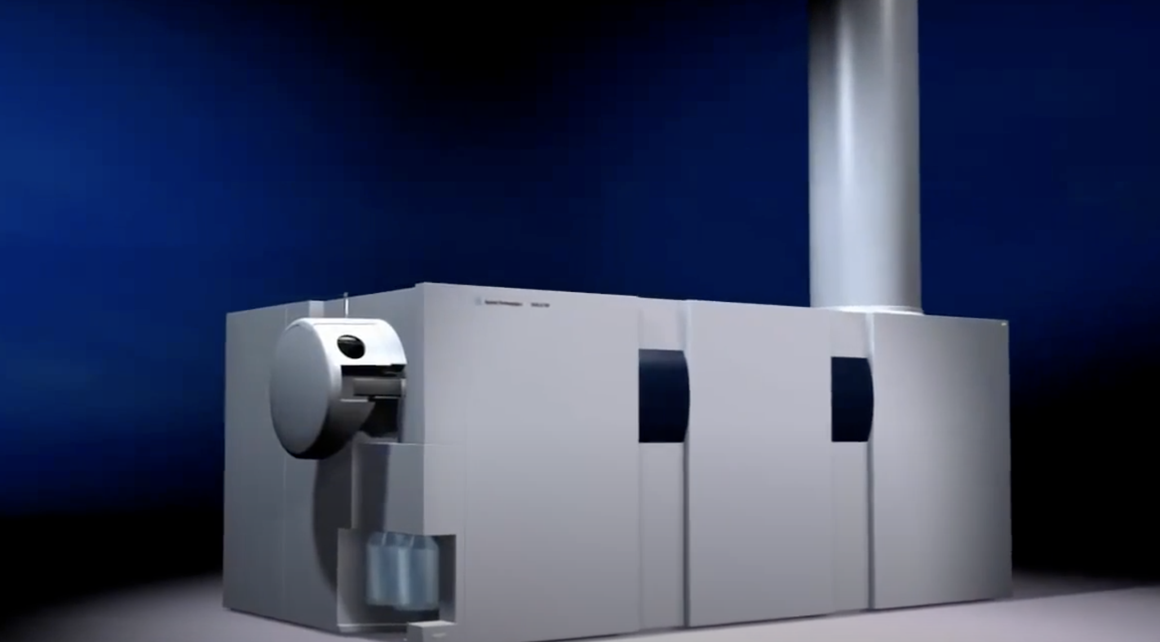
https://www.youtube.com/watch?v=W-DRL-V2Rkg

Slide 18
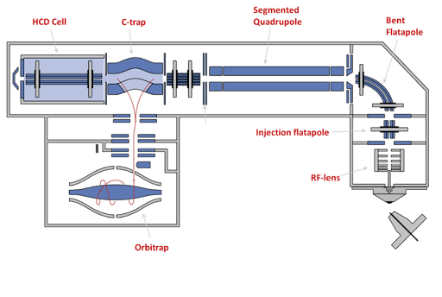
https://www.youtube.com/watch?v=RsFsaCkVqxM

Slide 19
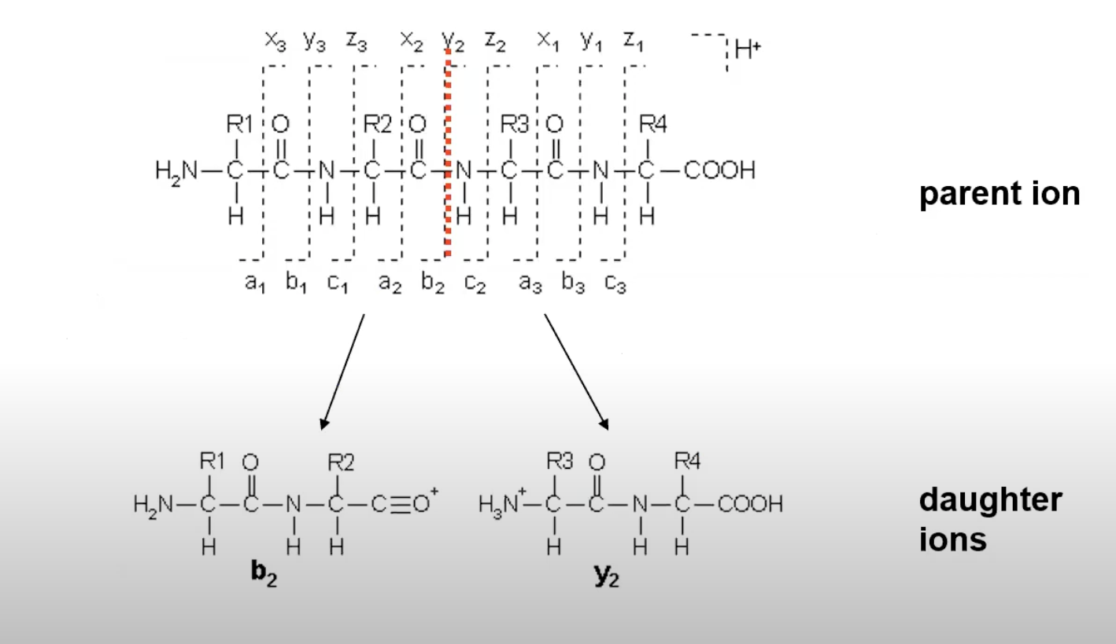

Slide 20
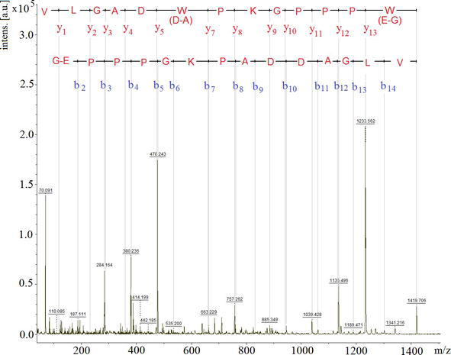

Slide 21
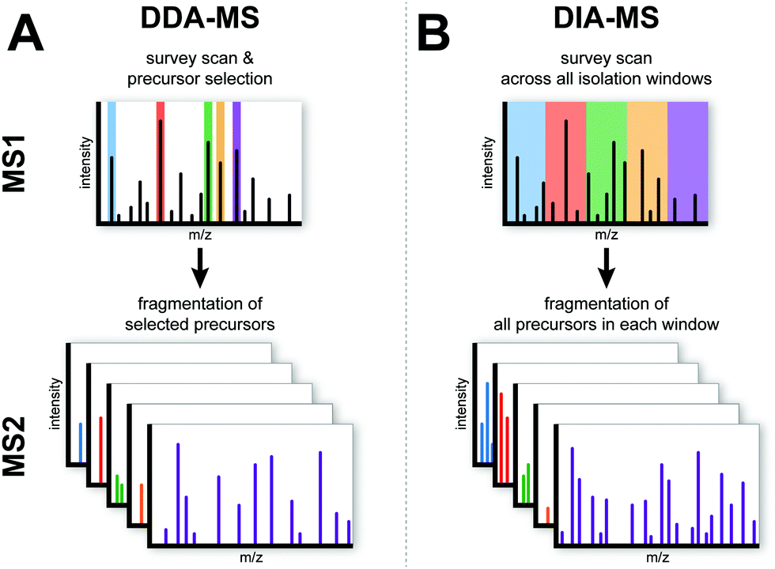
1. Data Acquisition technique

Slide 22
1. Data-Dependent Acquisition (DDA)
📌 Most common in discovery proteomics 🔹 MS¹ scans all ions 🔹 Selects the top N most intense ions 🔹 Fragments them (MS²) → identifies peptides
✅ Pros: good ID quality ❌ Cons: may miss low-abundance peptides (biased)

Slide 23
2. Data-Independent Acquisition (DIA)
📌 Newer and increasingly popular 🔹 MS scans all ions in defined m/z windows (not just top ones) 🔹 Fragments everything in those windows 🔹 Generates complex MS² spectra, analyzed with advanced software
✅ Pros: more comprehensive, less biased ❌ Cons: complex data, needs good spectral libraries

Slide 24


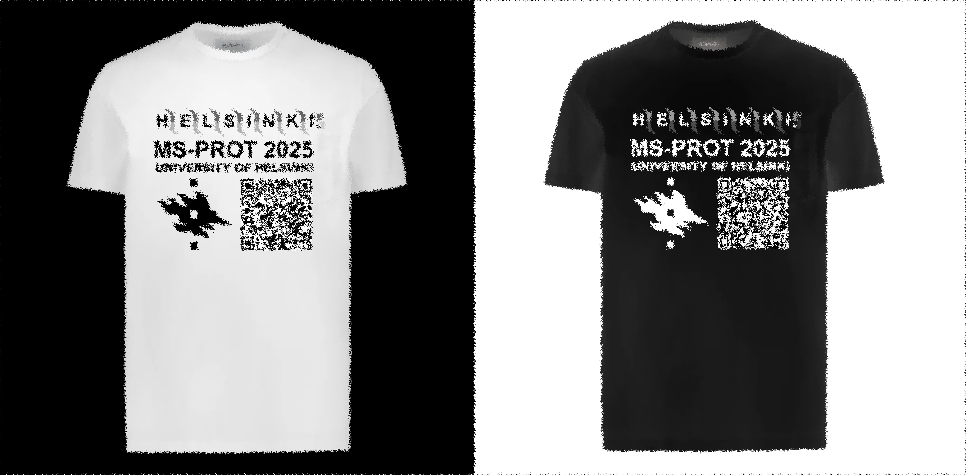
PPT file -> https://github.com/esnzgn/MSPROT
Designed by me

